Slide 1
Adaline and madaline
Prepared by
Aananda Bhusal(191701) Kishore Budhathoki(191711)
Reviewed by
Sibendra Timalsina
Deepak Rana Magar

Slide 2
Outline
Adaline
Architecture of ADALINE
Applications of adaline
Madaline
Architecture of Madaline
Applications of madaline

Slide 3
ADALINE
It stands for Adaptive Linear Neuron
It is a simple perceptron-like system that accomplishes classification by modifying weights in such a way as to diminish the Mean Square Error at every iteration.
Adaline is a single layer neural network that uses a linear activation function.
Adaline uses a cost function, such as mean squared error, to evaluate the difference between the predicted output and the actual output.

Slide 4
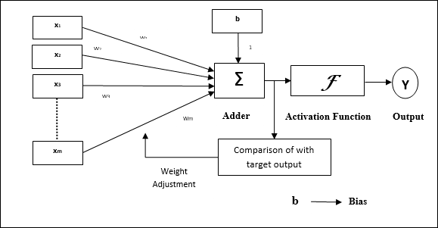
Architecture of ADALINE

Slide 5
Applications
Binary and multi-class classification tasks
Regression tasks
Stock market prediction
Credit scoring and fraud detection
Image recognition and image compression
Signal processing, such as speech recognition

Slide 6
Madaline
MADALINE (Multiple Adaptive Linear Neuron) is an artificial neural network that is an extension of the Adaline network.
MADALINE uses multiple Adaline units in a layered structure.
MADALINE uses a backpropagation algorithm to update the weights and minimize the cost function.
MADALINE is a multilayer neural network that can handle non-linearly separable data and can learn multiple classes.
MADALINE is an early example of a multi-layer neural network and has been used as a foundation for advanced neural network architectures.

Slide 7
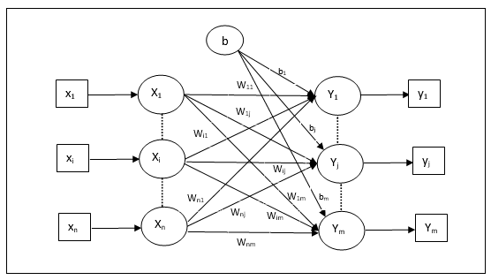
Architecture of Madaline

Slide 8
Application of madaline
Nonlinear function approximation
Pattern recognition
Control systems and robotics
Time series prediction
Speech recognition and Handwriting recognition
Image processing

Slide 9
Thank you

